Slide 1
Phisics 2
Md Mukhlesur Rahman
BSc (Hon’s) M.Sc (Chemistry) M.Ed
Instructor (Non-Tech)

Slide 2
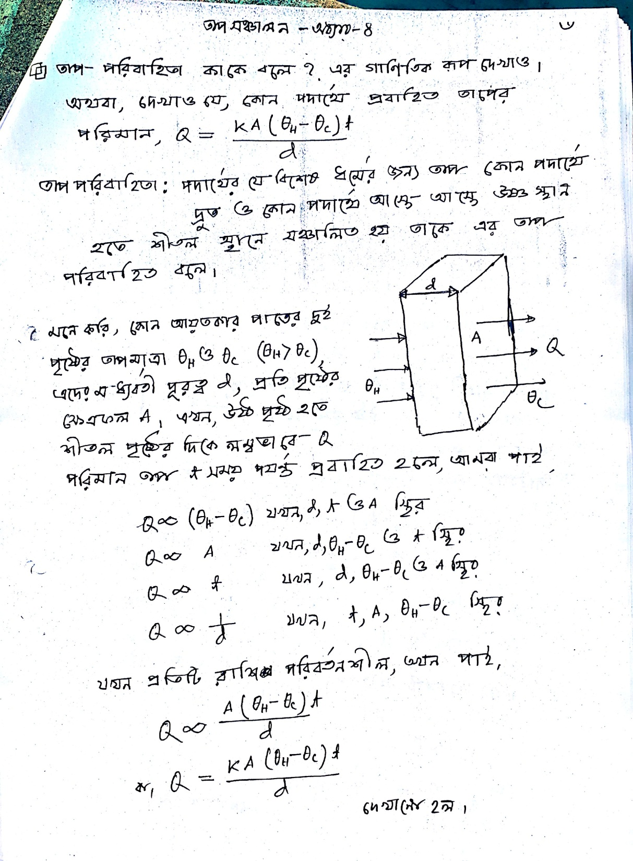

Slide 3
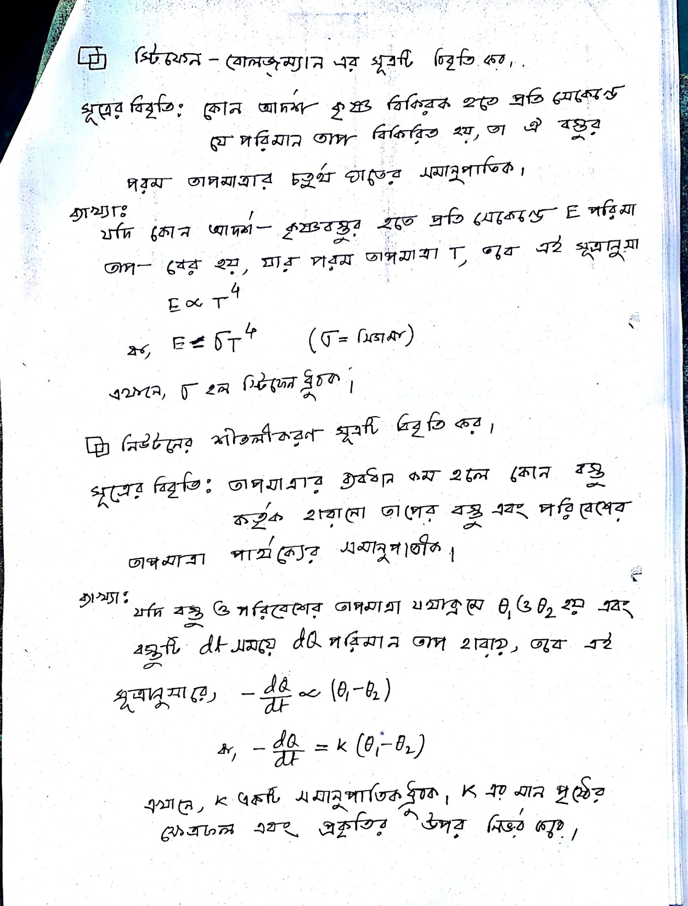

Slide 4
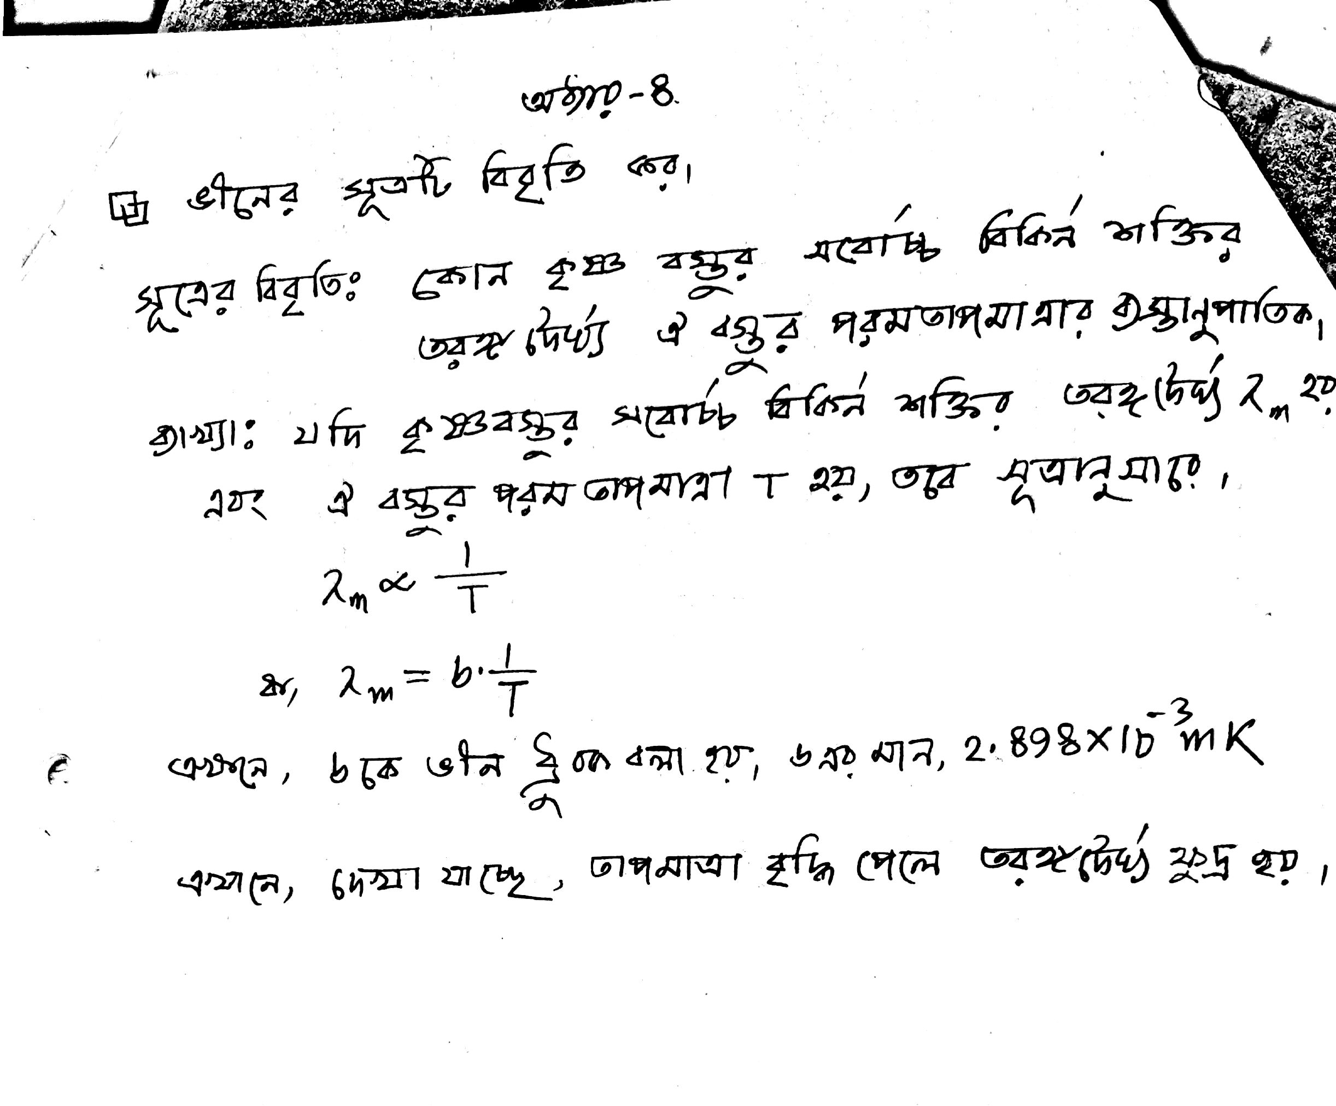

Slide 5
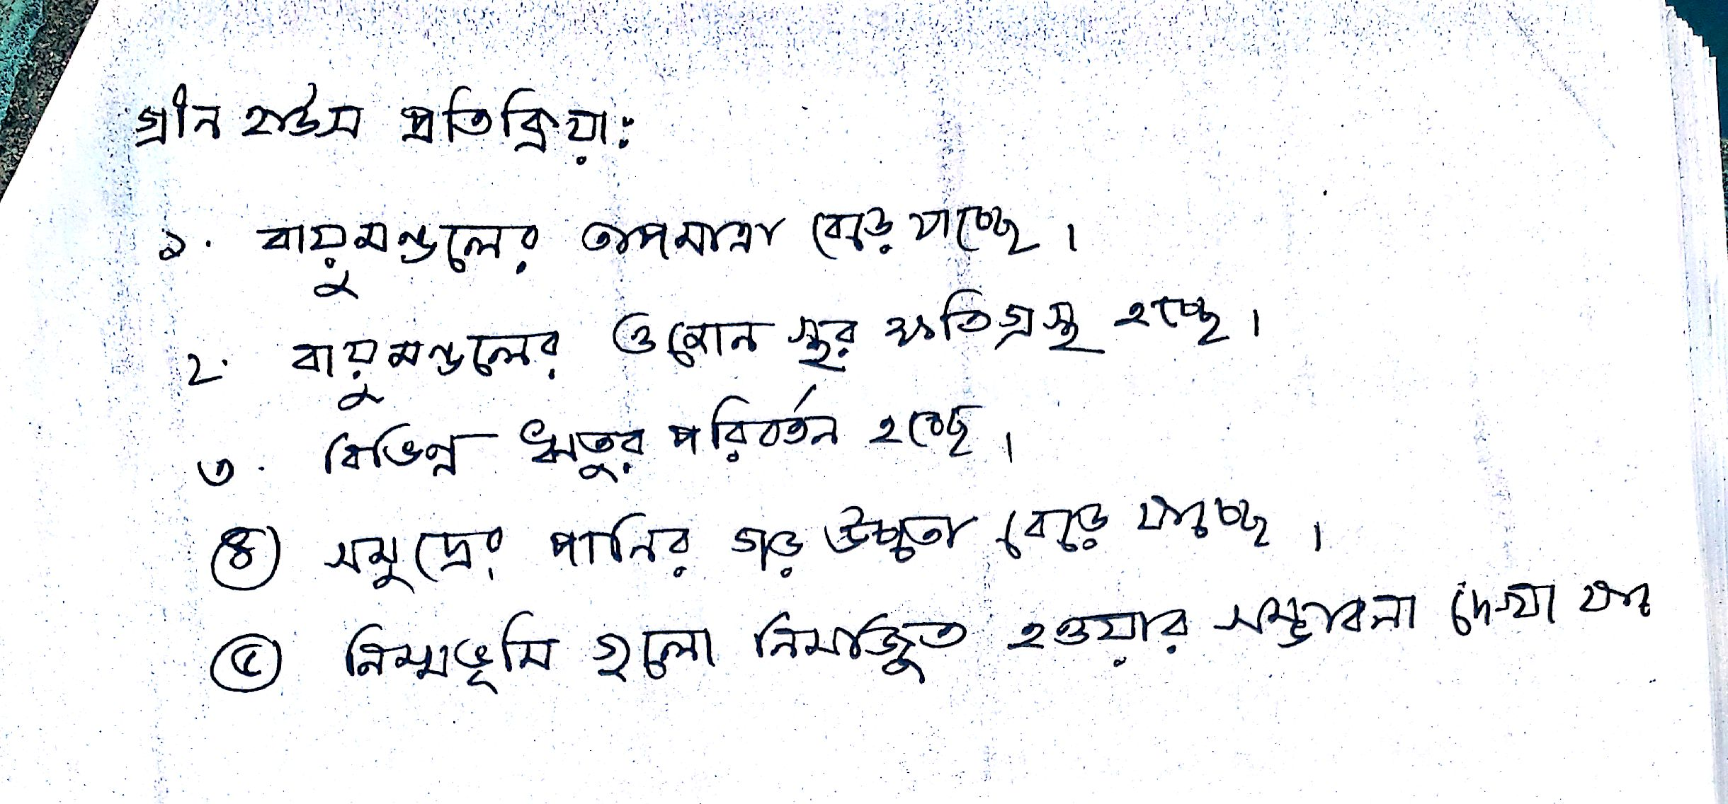

Slide 6
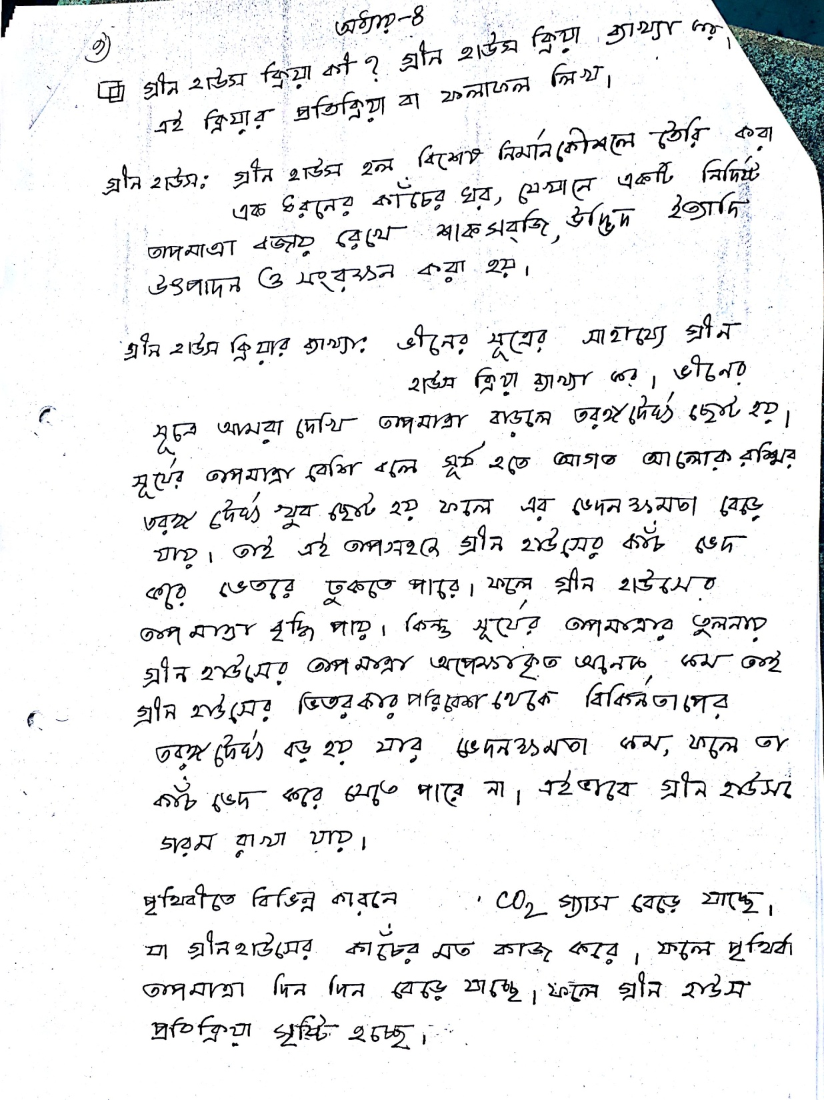

Slide 7
Rfresh
Thank You

