Slide 1
Phisics 2 (Class-6)
Md Mukhlesur Rahman
B.Sc (Hon’s) M.Sc (Chemistry). M.ed
Instructor (Non –tech)

Slide 2
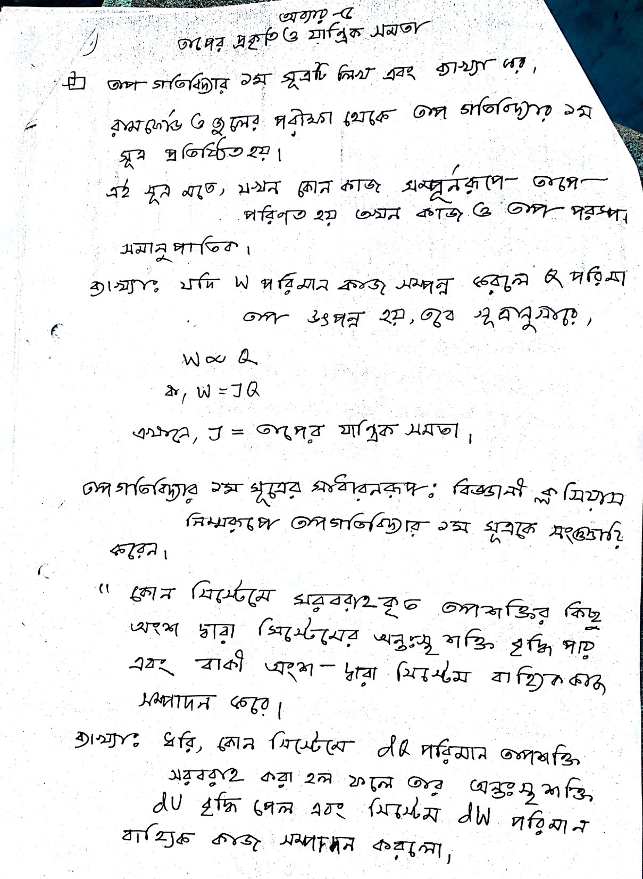

Slide 3
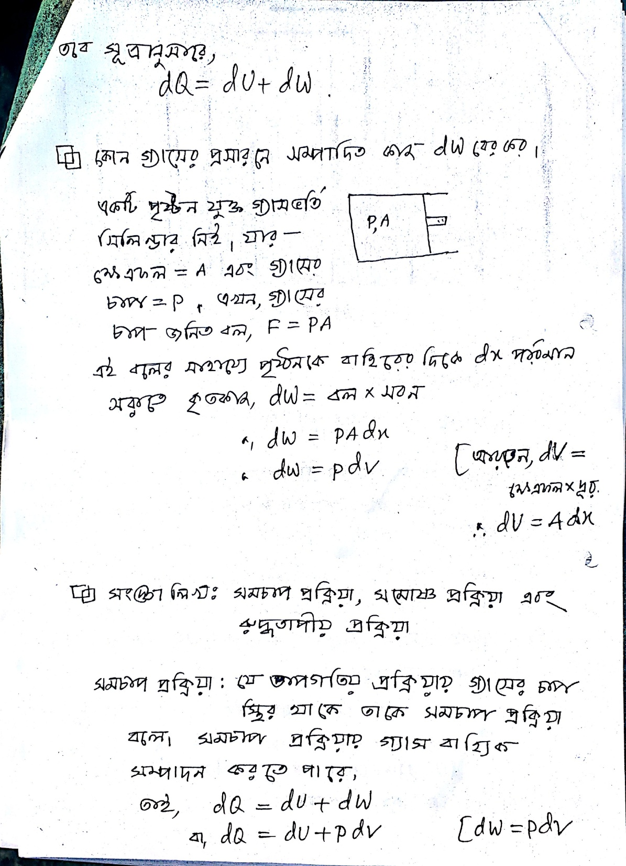

Slide 4
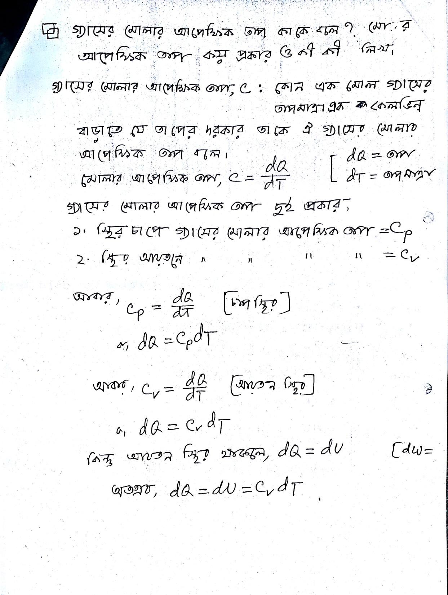

Slide 5
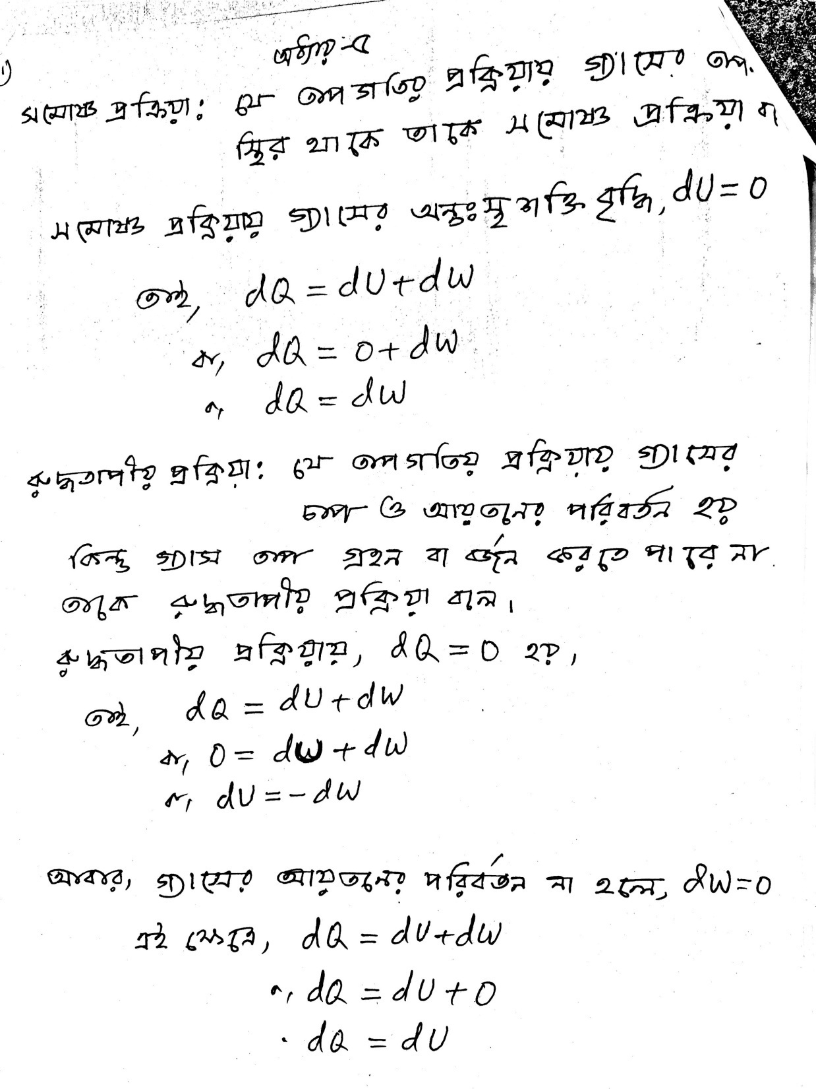

Slide 6
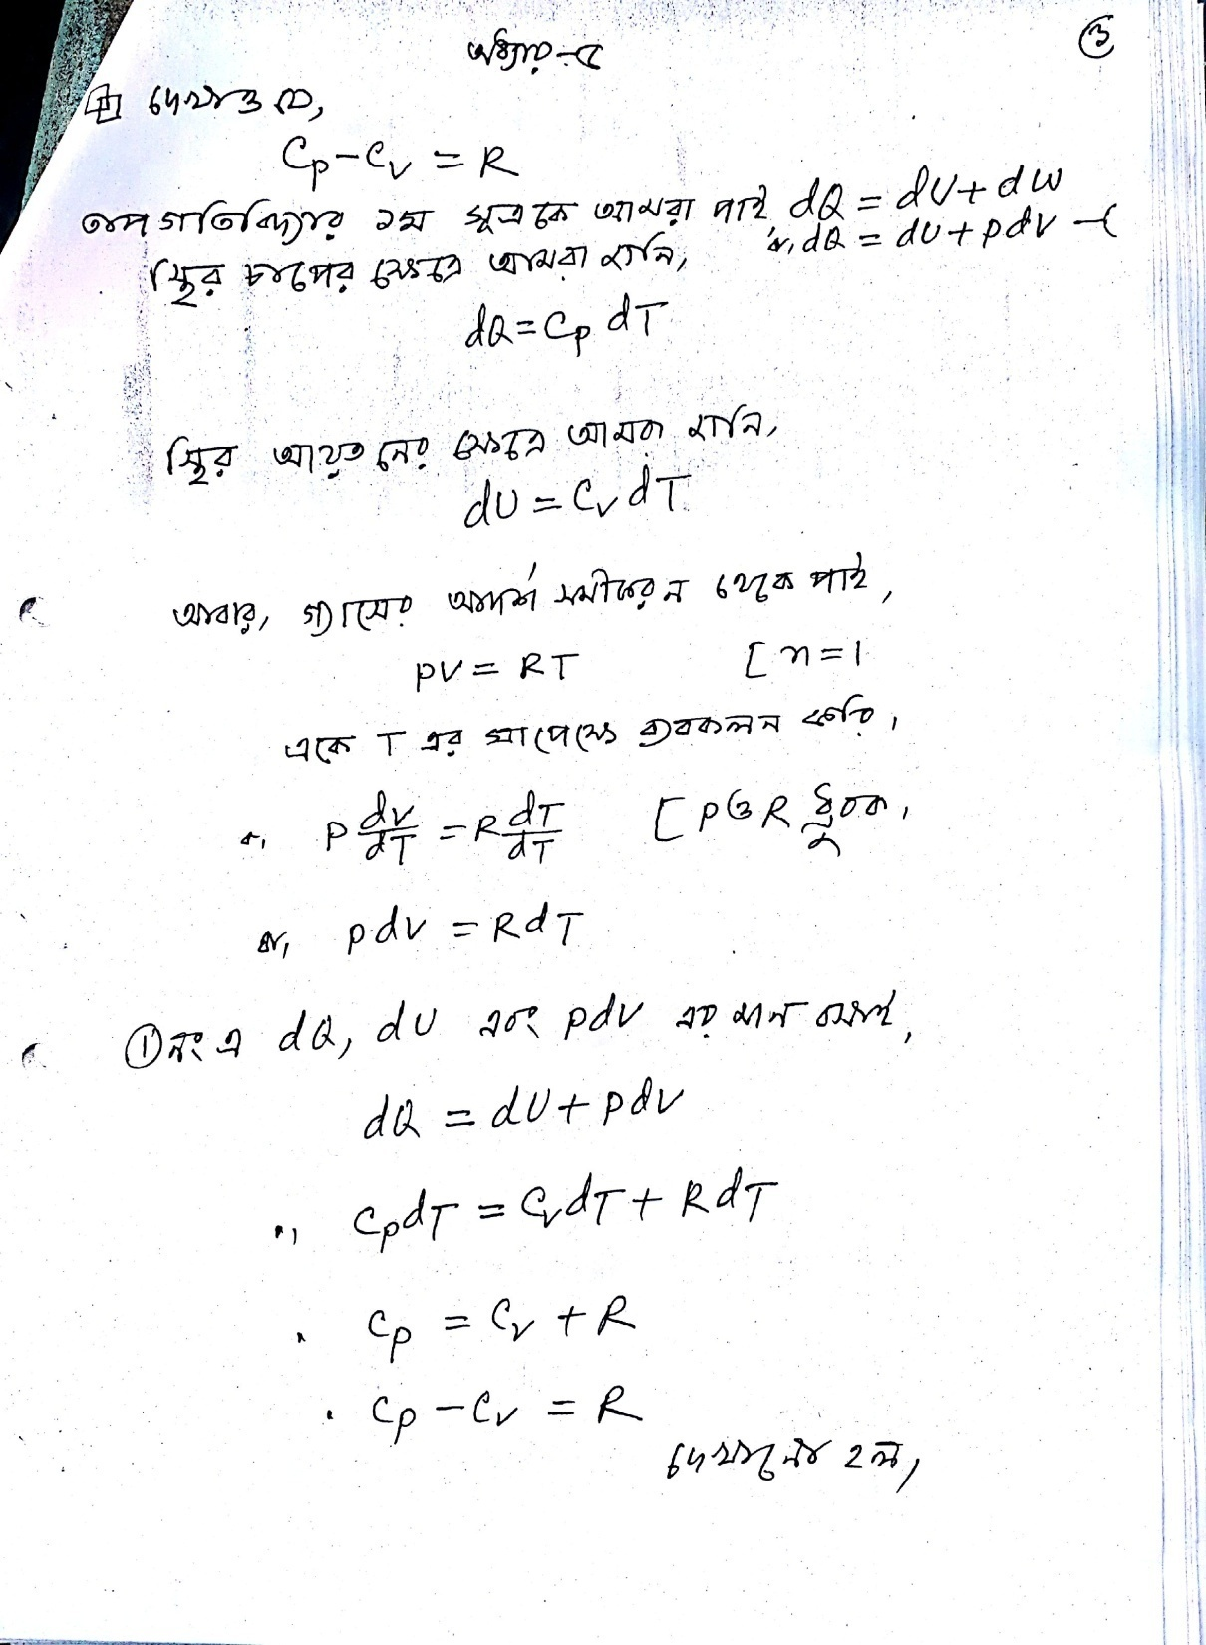

Slide 7
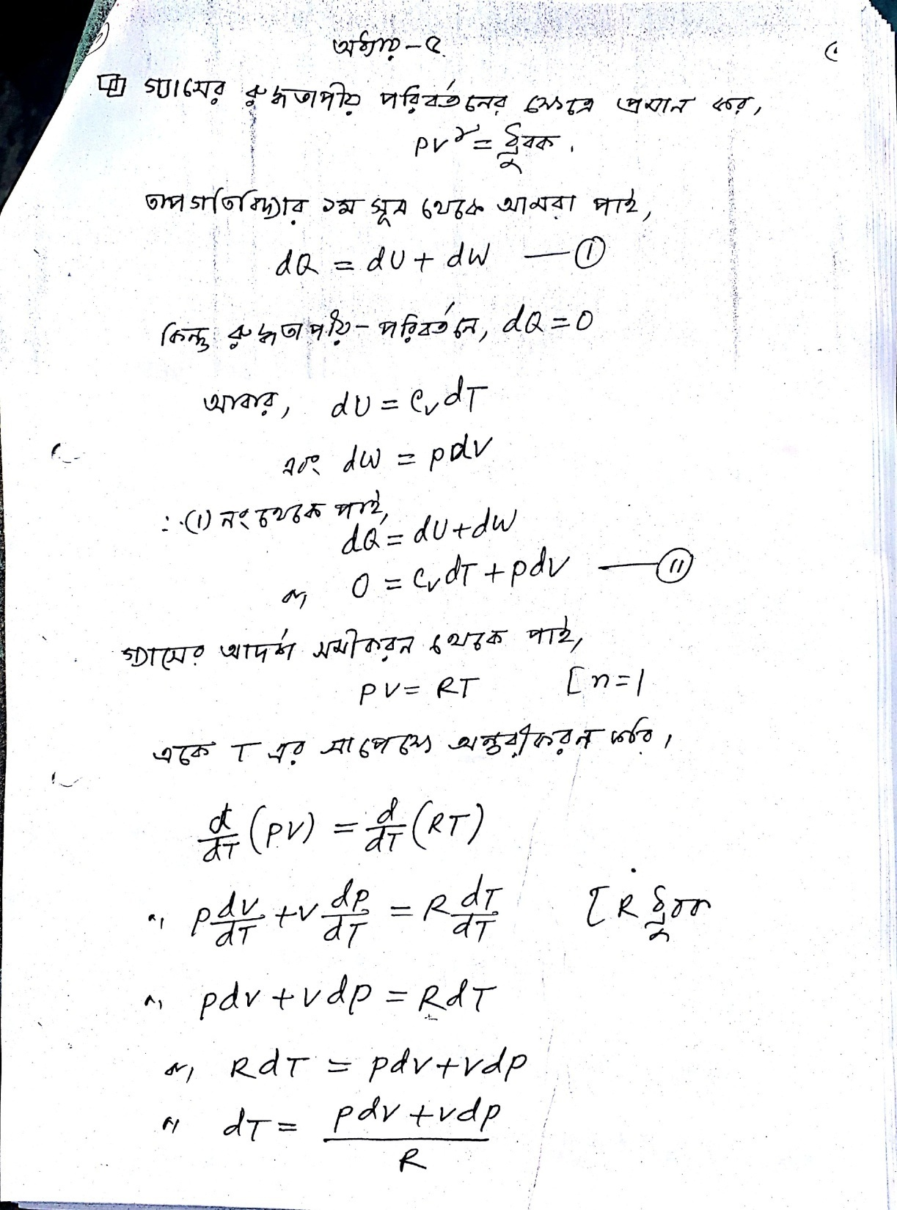

Slide 8
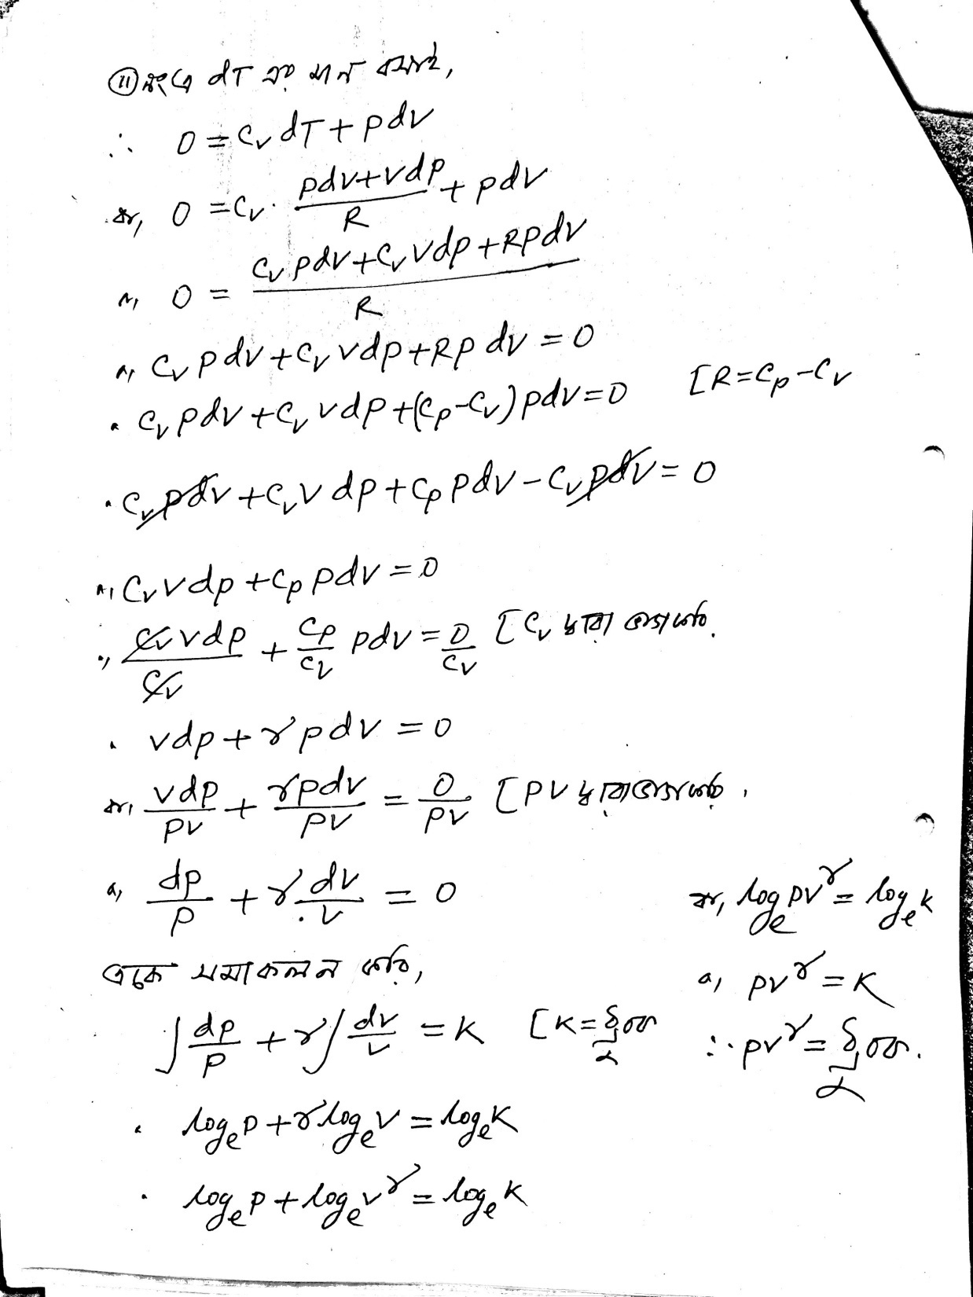

Slide 9
Keep Safe
Thank You

